Slide 1


Slide 2




SILVER BLUFF HIGH SCHOOL
SCHEMATIC DESIGN SUMMARY
AIKEN COUNTY PUBLIC SCHOOL DISTRICT
AIKEN COUNTY PUBLIC SCHOOL DISTRICT SILVER BLUFF HIGH SCHOOL | October 14, 2025 | P-2

Slide 3
The additions to Silver Bluff High School were developed through a collaborative process involving extensive discussions and interviews with district staff, facilities personnel, the principal, department heads, teachers, counselors, community members, and Hood Construction. These discussions helped shape a design that meets both current and future needs.
Key goals included creating a secure and highly visible main entrance, expanding classroom capacity, modernizing science labs, and establishing future ready CTE spaces for welding, agricultural science, and culinary arts. The project also includes new administrative and guidance offices, a state-of-the art competition gym and weight room, enhanced facilities for the award-winning band program, and a dedicated NJROTC suite.
A highlight of the addition is the Veterans Walk, a community-driven feature that will relocate existing monuments, military flags, and commemorative pavers to a prominent space between the new entrance and the NJROTC wing.
Renovations to the existing building will include improved corridor sight lines, larger special education classrooms, and a new home for onsite transportation services.
PROJECT GOALS
AIKEN COUNTY PUBLIC SCHOOL DISTRICT SILVER BLUFF HIGH SCHOOL | October 14, 2025 | P-3

Slide 4
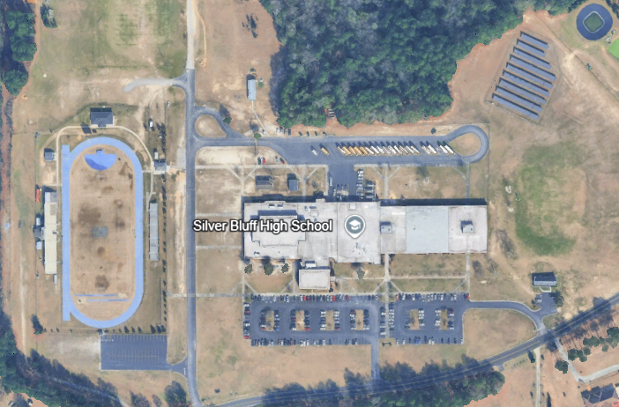
PROJECT SITE
AIKEN COUNTY PUBLIC SCHOOL DISTRICT SILVER BLUFF HIGH SCHOOL | October 14, 2025 | P-4

Slide 5
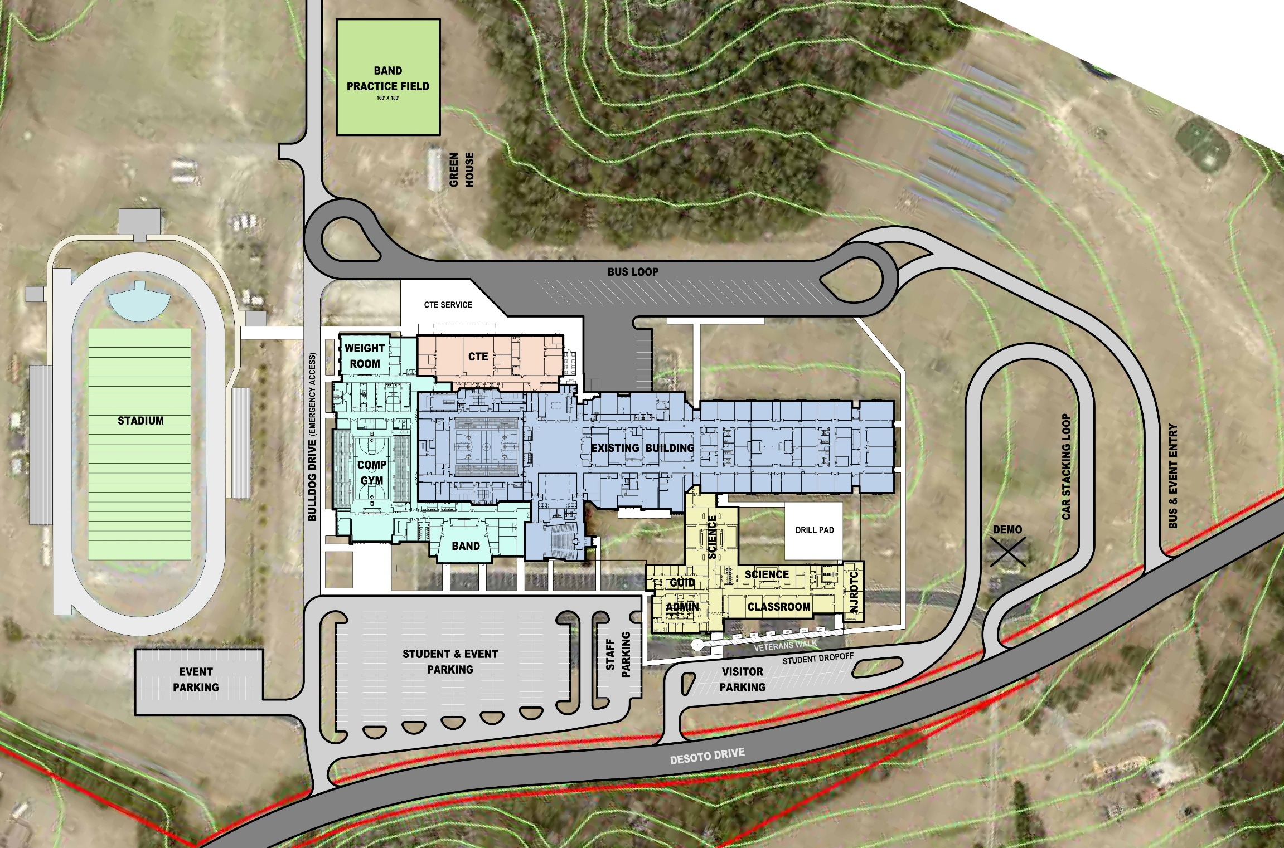
1C
SITE PLAN
1B
1D
1A
AIKEN COUNTY PUBLIC SCHOOL DISTRICT SILVER BLUFF HIGH SCHOOL | October 14, 2025 | P-5

Slide 6
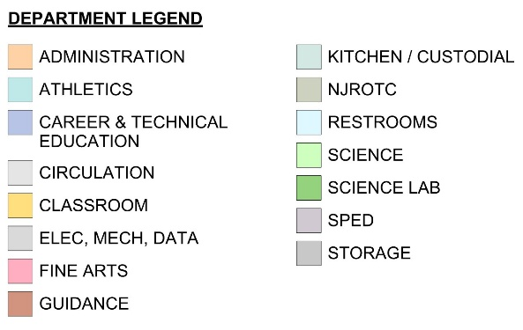
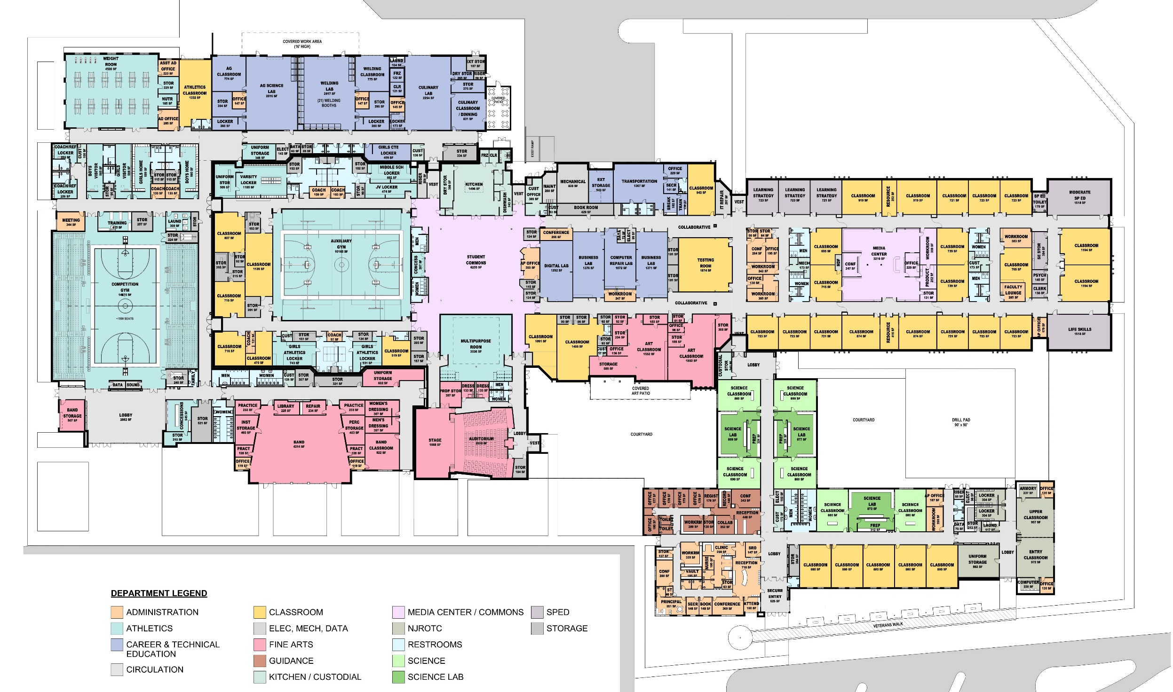
SILVER BLUFF HIGH SCHOOL
OVERALL FLOOR PLAN (PHASE 1)
OVERALL PLAN
AIKEN COUNTY PUBLIC SCHOOL DISTRICT SILVER BLUFF HIGH SCHOOL | October 14, 2025 | P-6

Slide 7
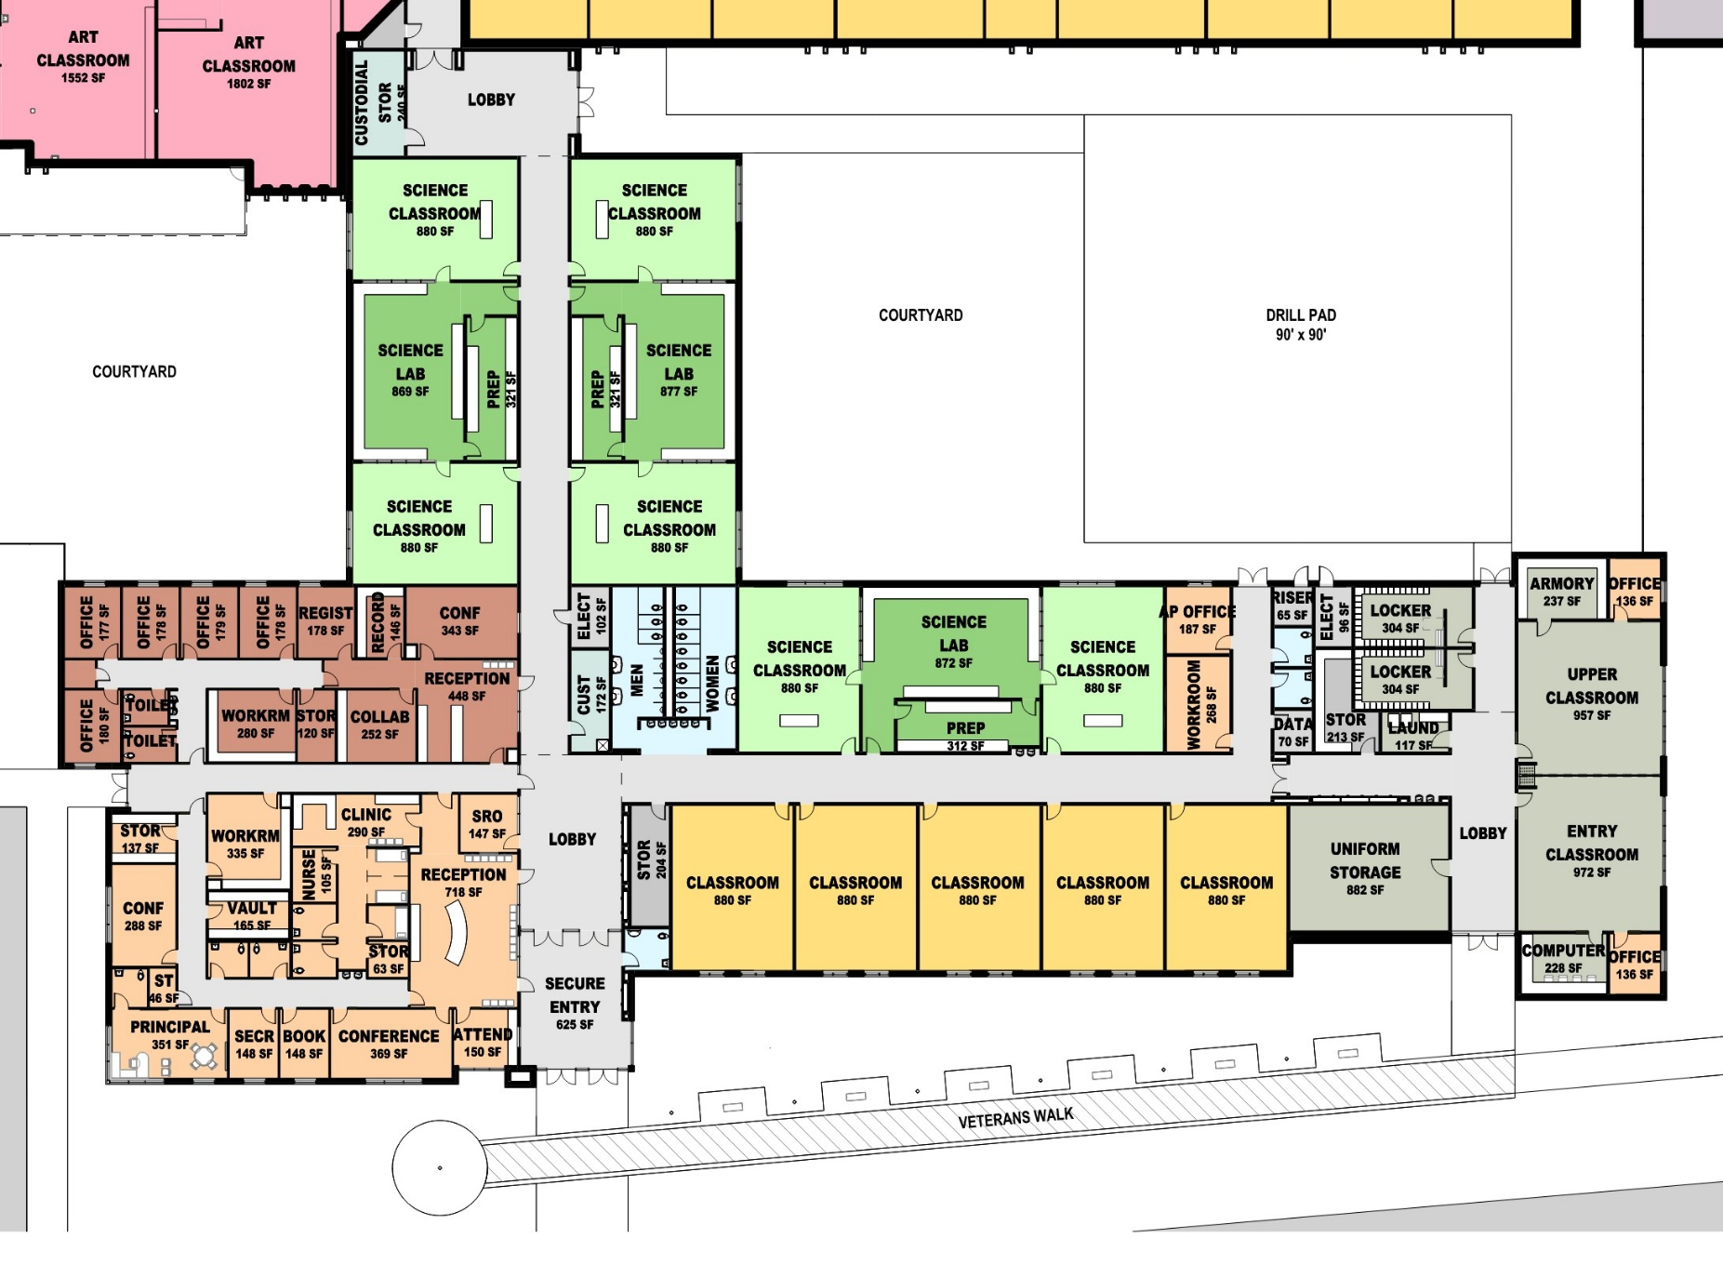
SILVER BLUFF HIGH SCHOOL
ADMIN & CLASSROOM FLOOR PLAN
AREA A PLAN
AIKEN COUNTY PUBLIC SCHOOL DISTRICT SILVER BLUFF HIGH SCHOOL | October 14, 2025 | P-7

Slide 8
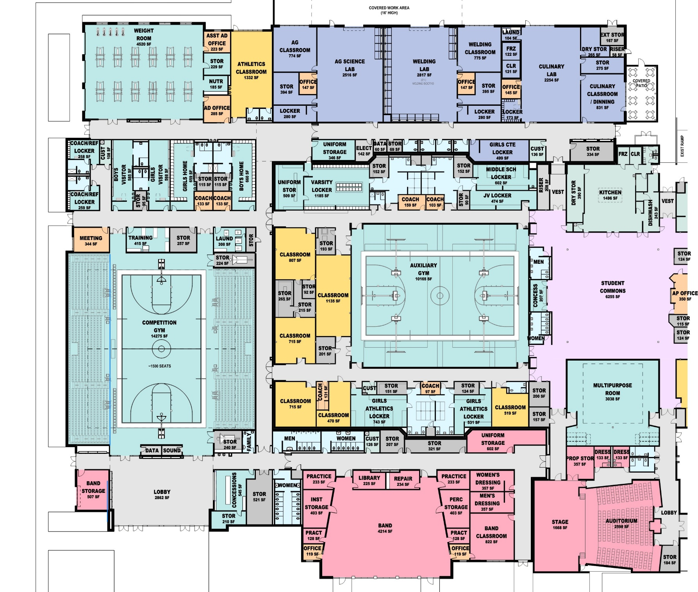
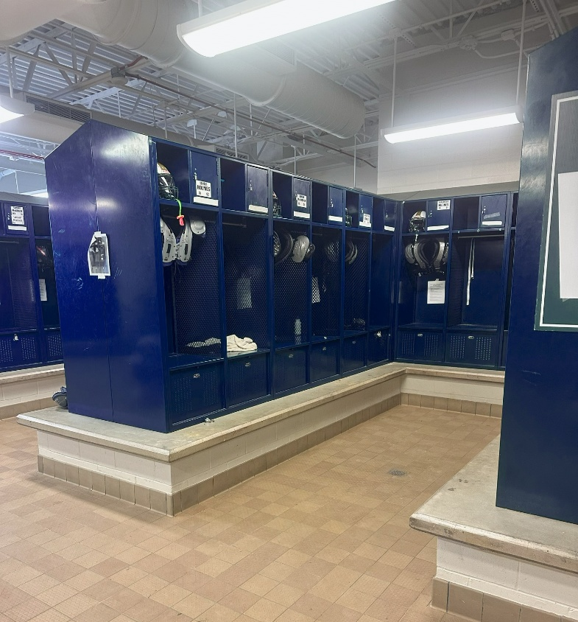
SILVER BLUFF HIGH SCHOOL
ATHLETICS FLOOR PLAN
AREA B PLAN
AIKEN COUNTY PUBLIC SCHOOL DISTRICT SILVER BLUFF HIGH SCHOOL | October 14, 2025 | P-8

Slide 9
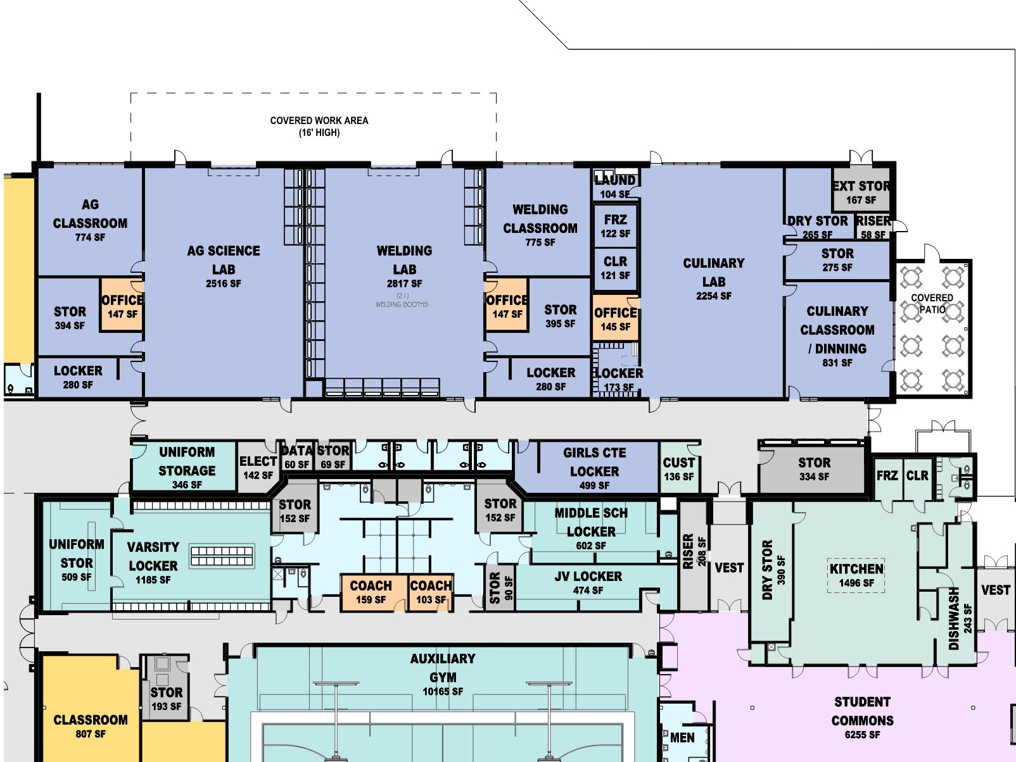
SILVER BLUFF HIGH SCHOOL
CTE FLOOR PLAN
AREA C PLAN
AIKEN COUNTY PUBLIC SCHOOL DISTRICT SILVER BLUFF HIGH SCHOOL | October 14, 2025 | P-9

Slide 10
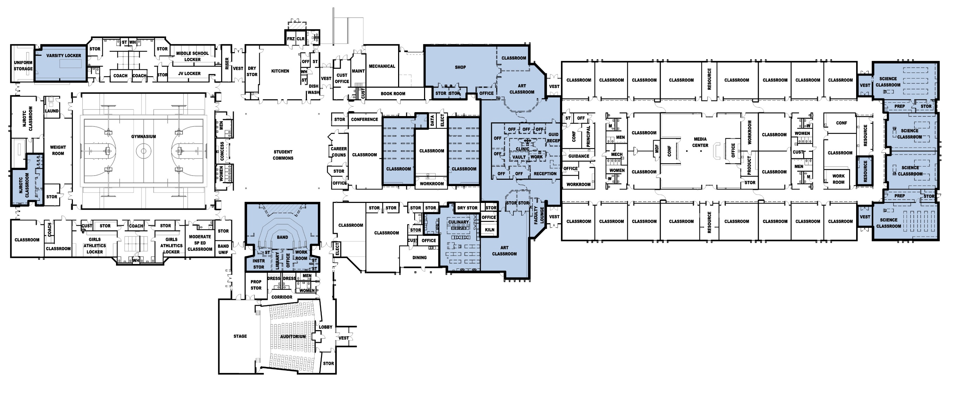
SILVER BLUFF HIGH SCHOOL
DEMOLITION FLOOR PLAN
DEMO PLAN
AIKEN COUNTY PUBLIC SCHOOL DISTRICT SILVER BLUFF HIGH SCHOOL | October 14, 2025 | P-10

Slide 11
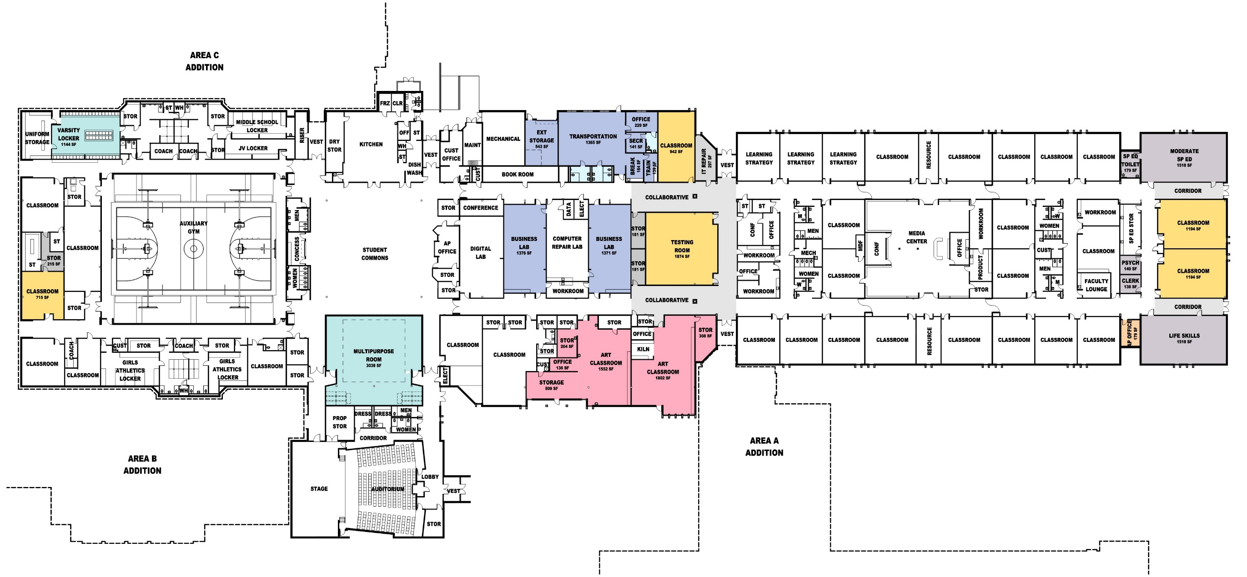
SILVER BLUFF HIGH SCHOOL
RENOVATION FLOOR PLAN
AREA D PLAN
AIKEN COUNTY PUBLIC SCHOOL DISTRICT SILVER BLUFF HIGH SCHOOL | October 14, 2025 | P-11

Slide 12
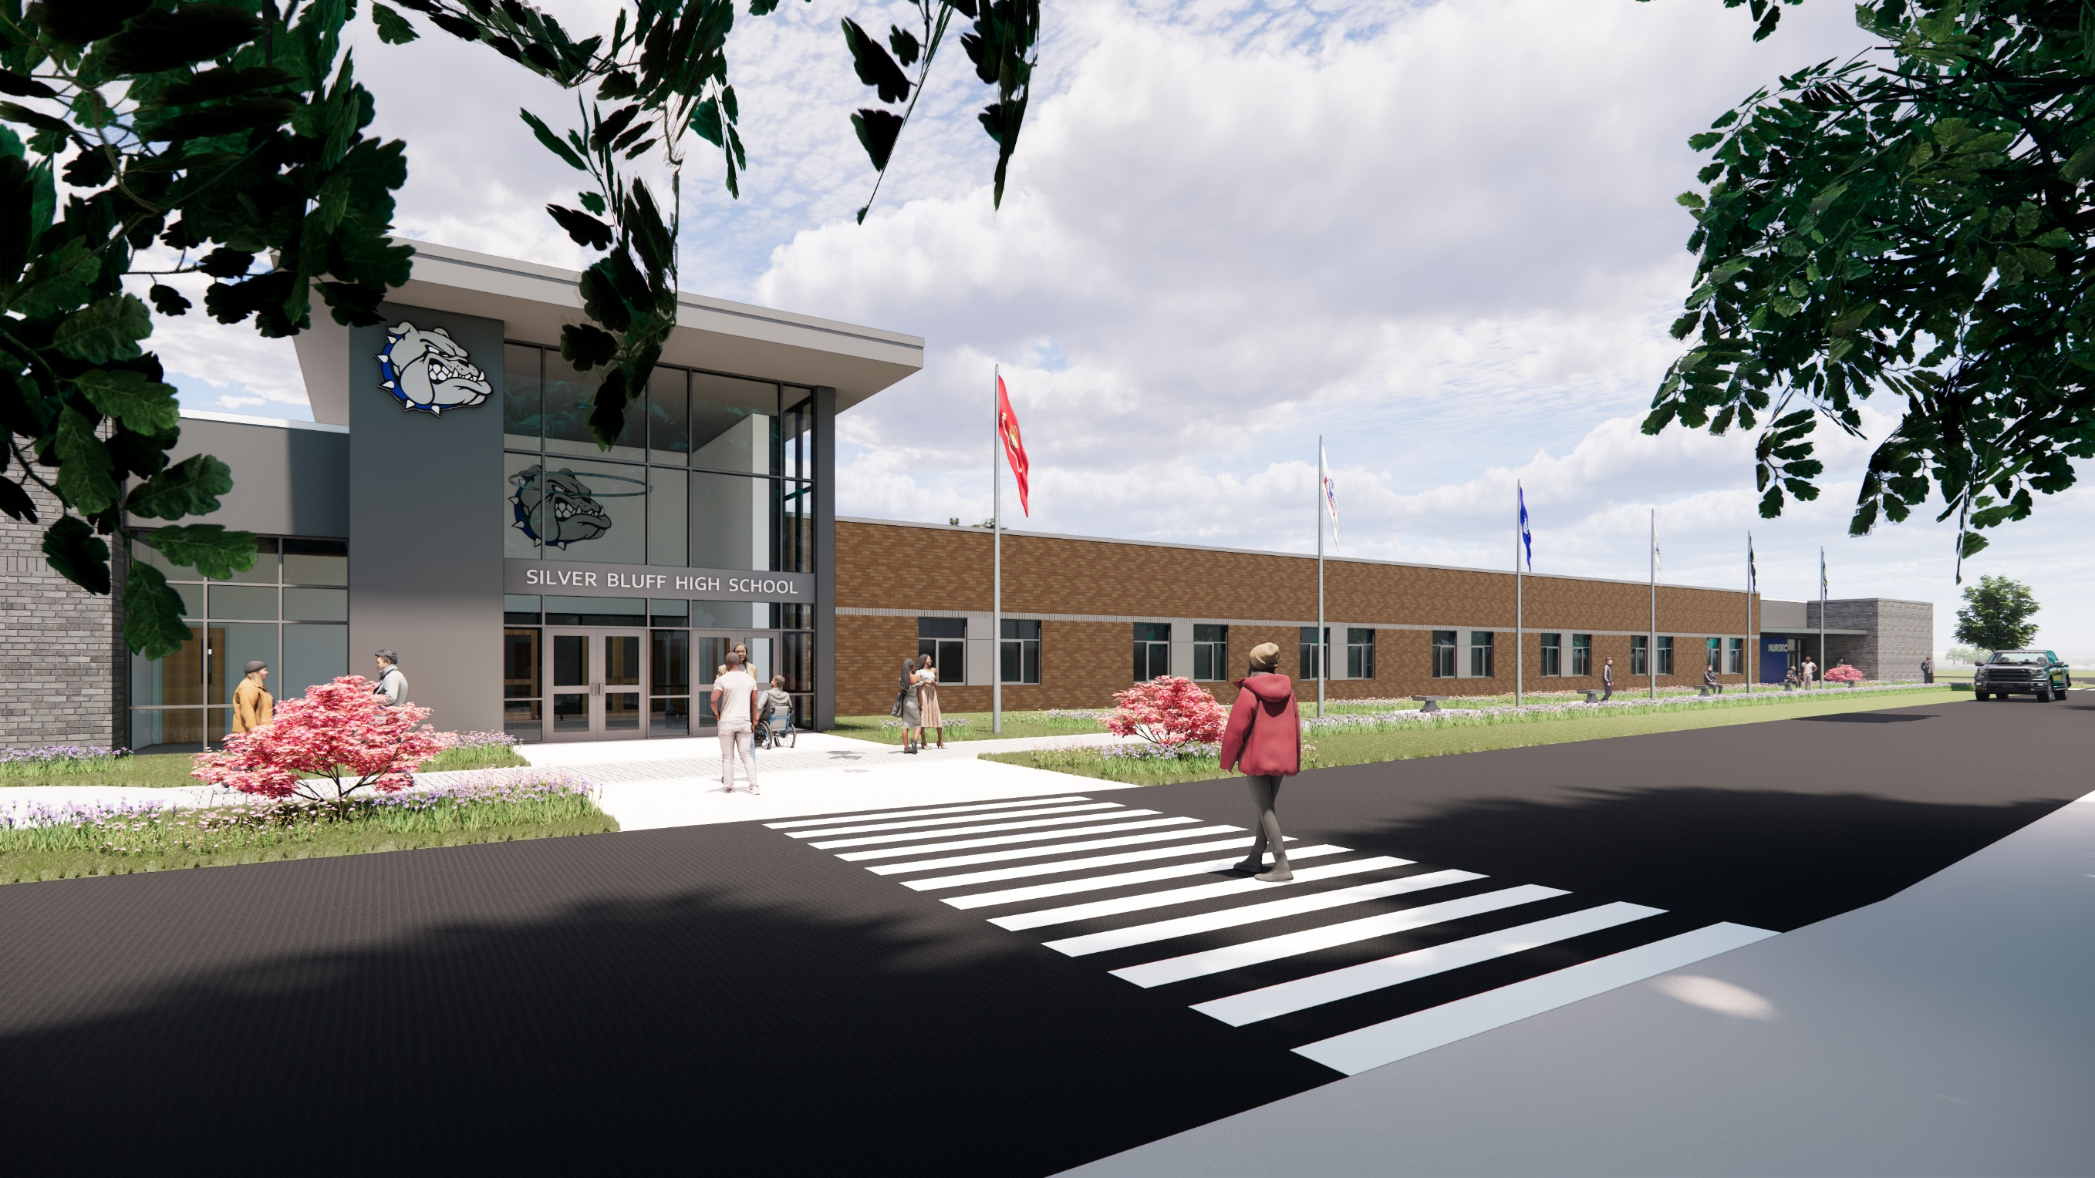
MAIN ENTRANCE
SILVER BLUFF HIGH SCHOOL RENDERING
AIKEN COUNTY PUBLIC SCHOOL DISTRICT SILVER BLUFF HIGH SCHOOL | October 14, 2025 | P-12

Slide 13
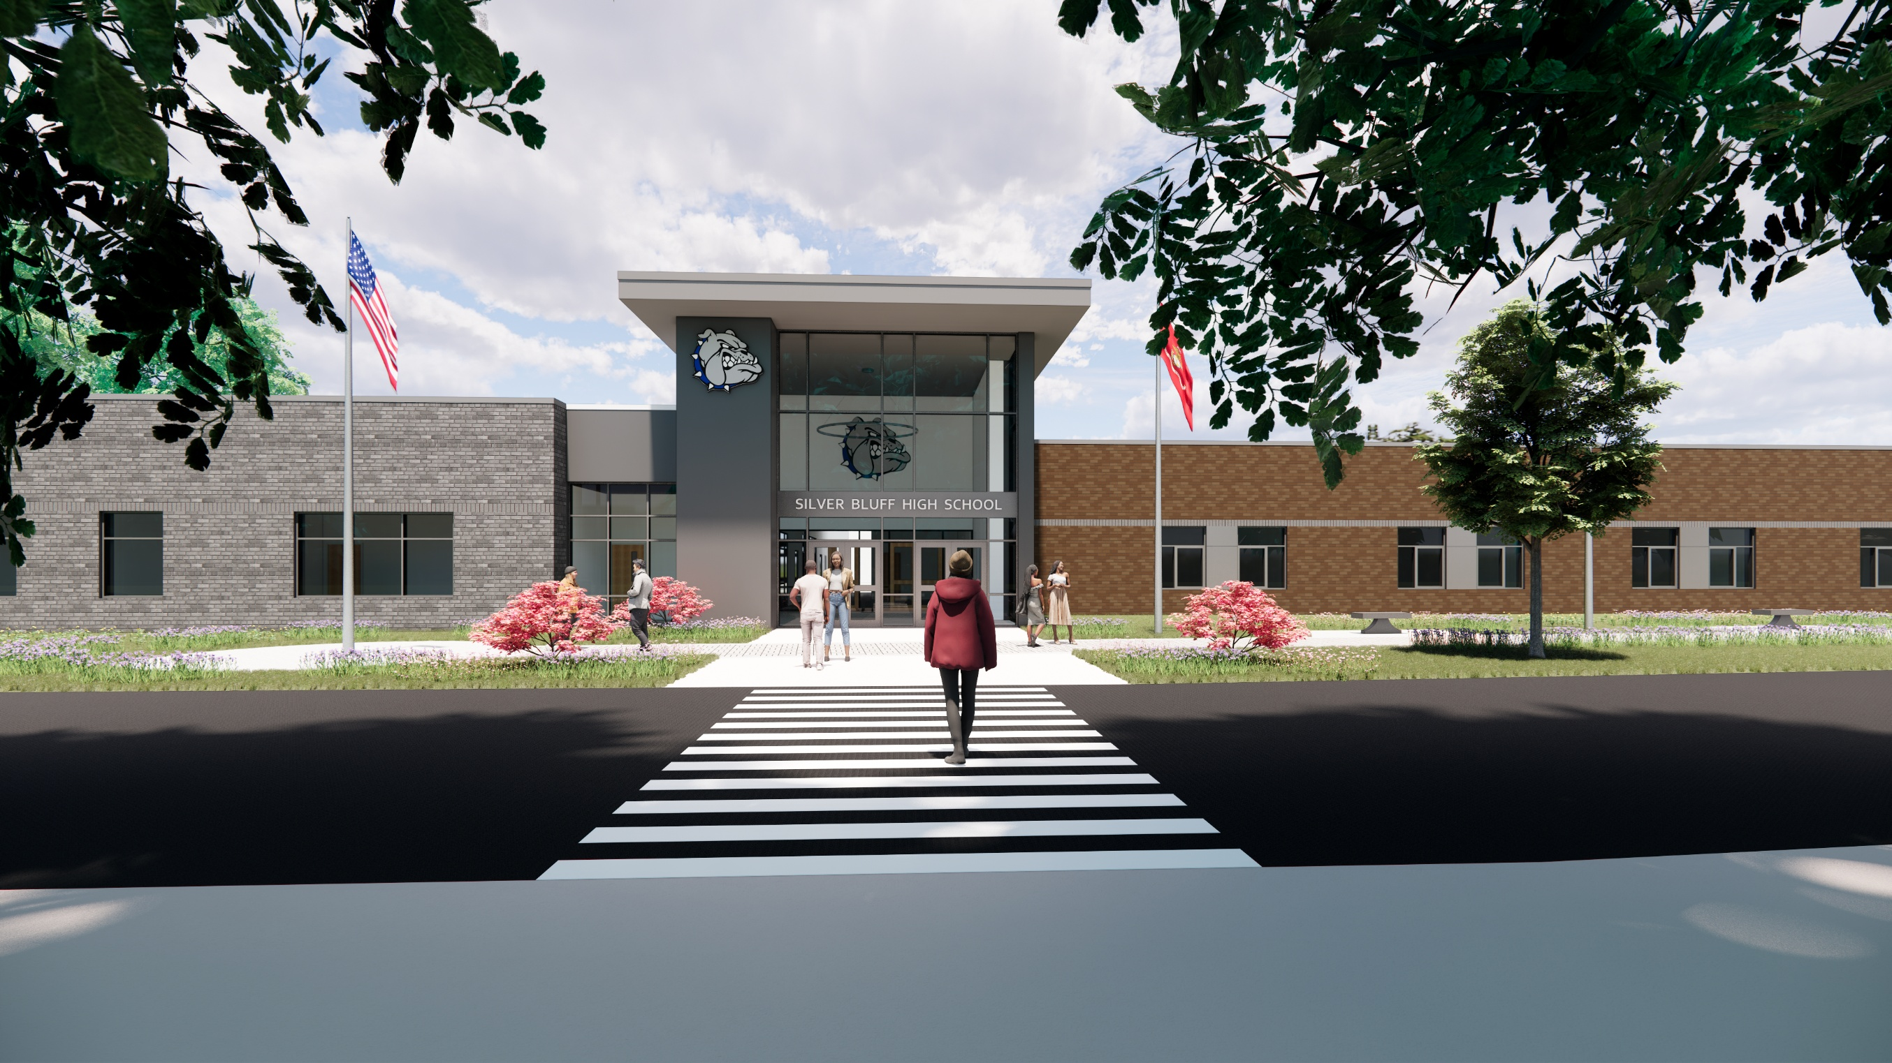
MAIN ENTRANCE
SILVER BLUFF HIGH SCHOOL RENDERING
AIKEN COUNTY PUBLIC SCHOOL DISTRICT SILVER BLUFF HIGH SCHOOL | October 14, 2025 | P-13

Slide 14
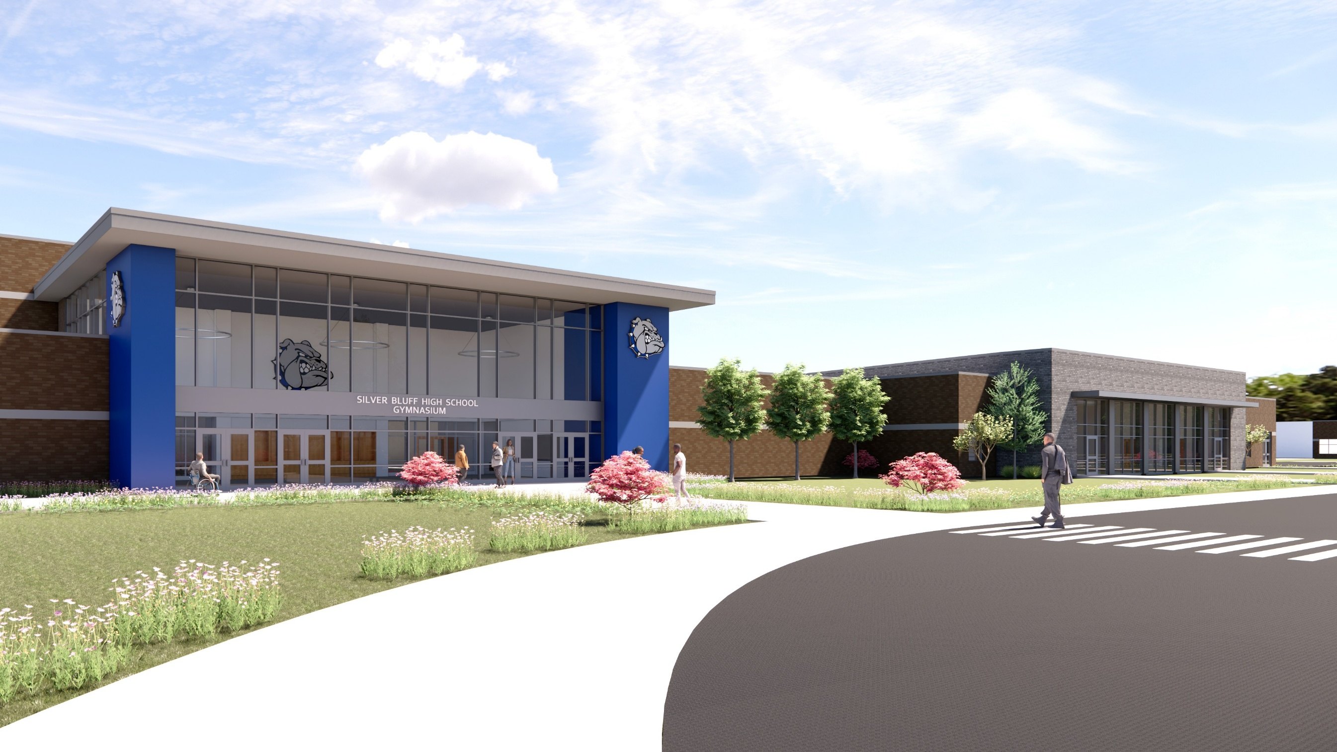
GYM ENTRANCE & BAND ROOM
SILVER BLUFF HIGH SCHOOL RENDERING
AIKEN COUNTY PUBLIC SCHOOL DISTRICT SILVER BLUFF HIGH SCHOOL | October 14, 2025 | P-14

Slide 15
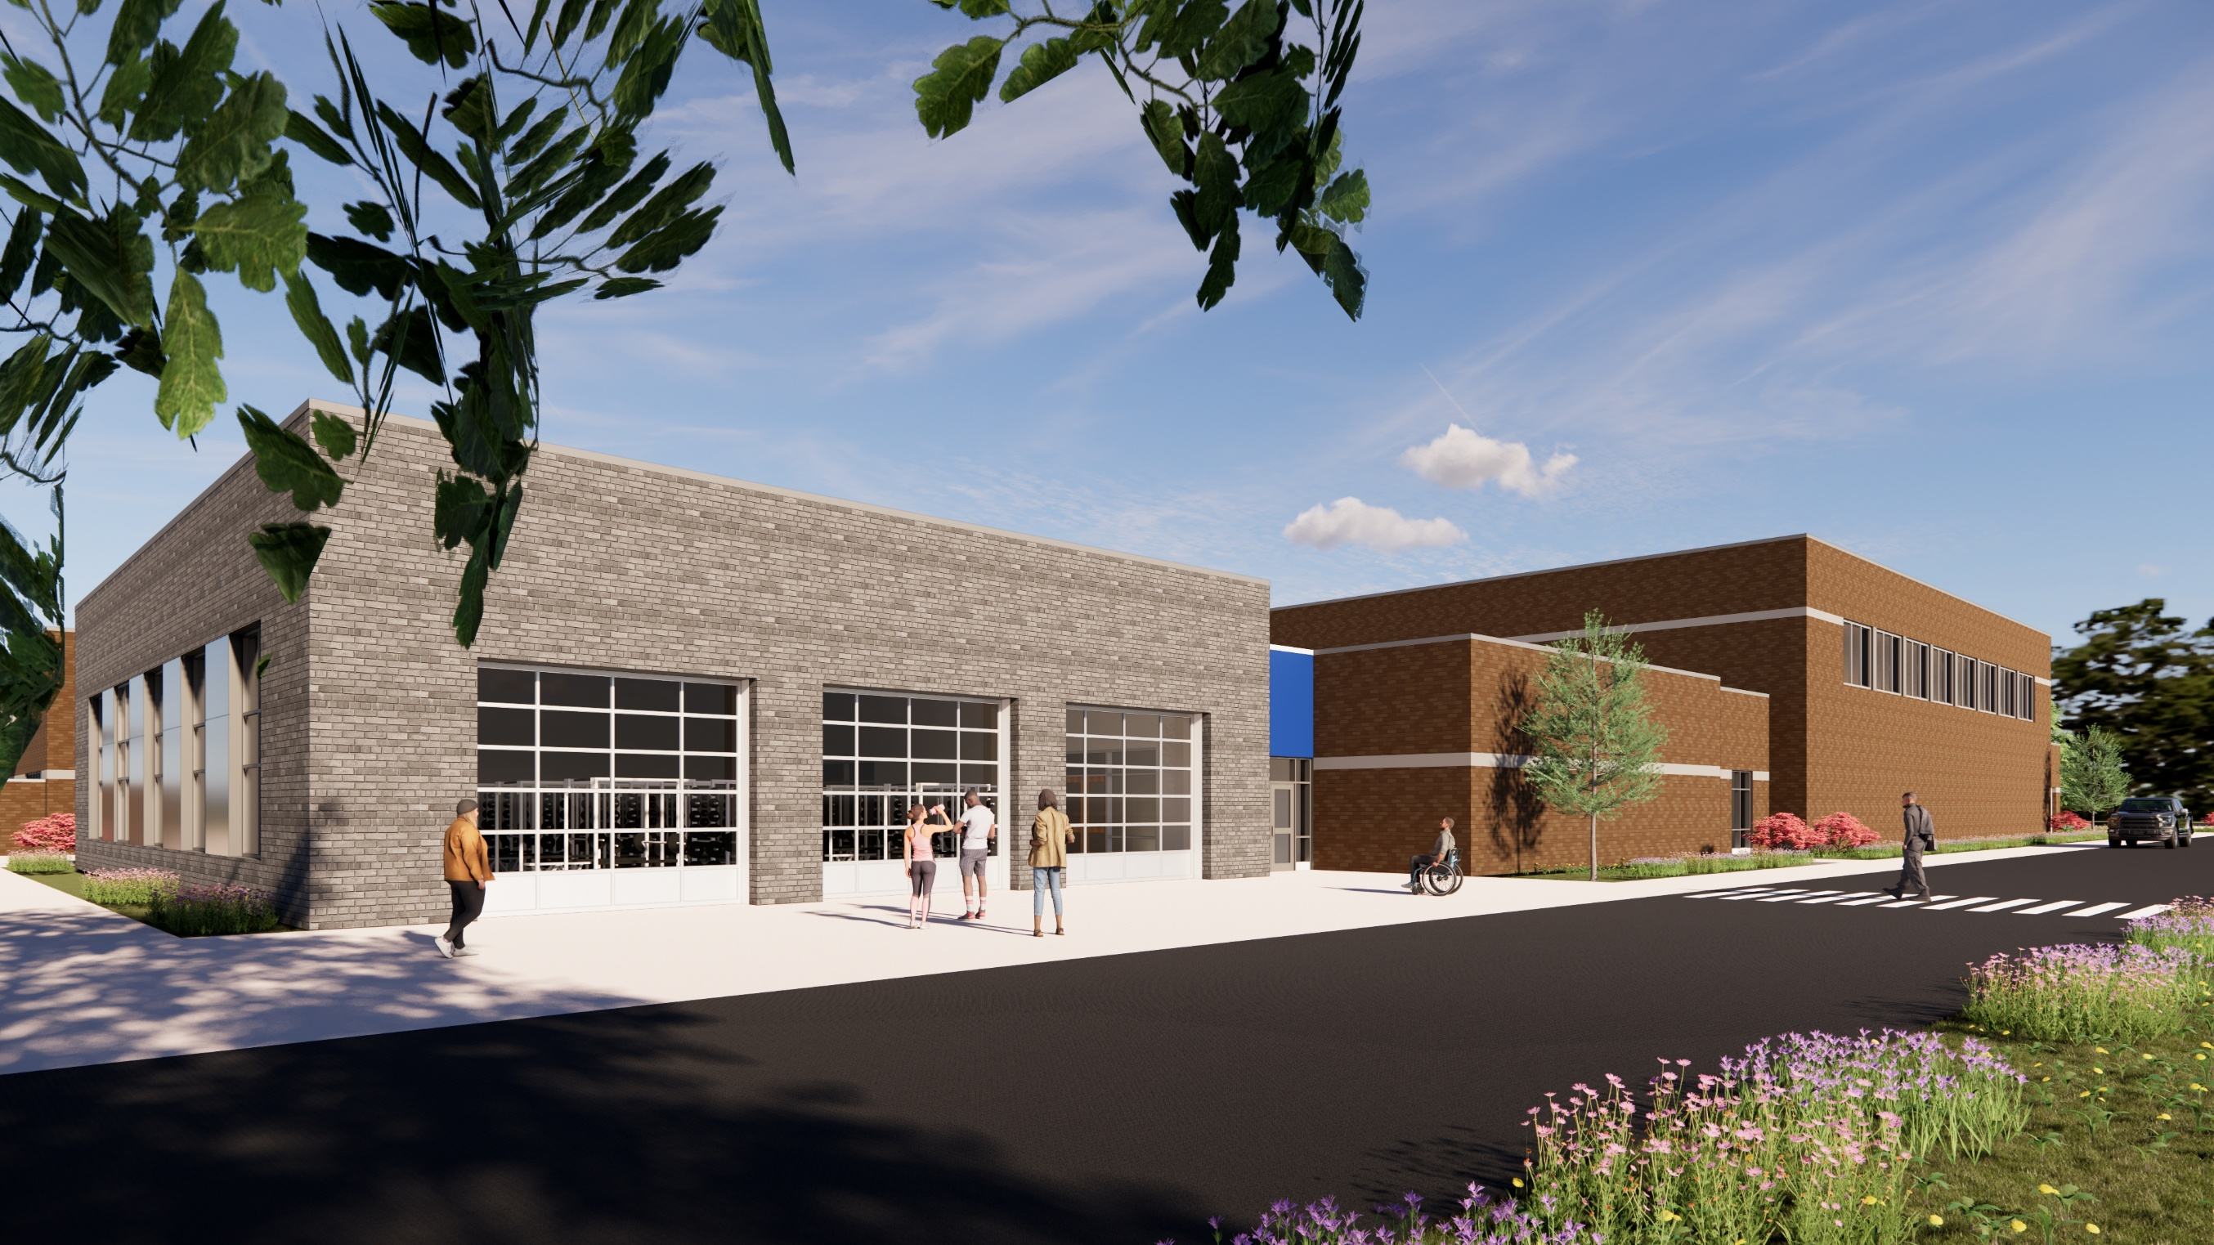
GYM & WEIGHT ROOM
SILVER BLUFF HIGH SCHOOL RENDERING
AIKEN COUNTY PUBLIC SCHOOL DISTRICT SILVER BLUFF HIGH SCHOOL | October 14, 2025 | P-15

Slide 16
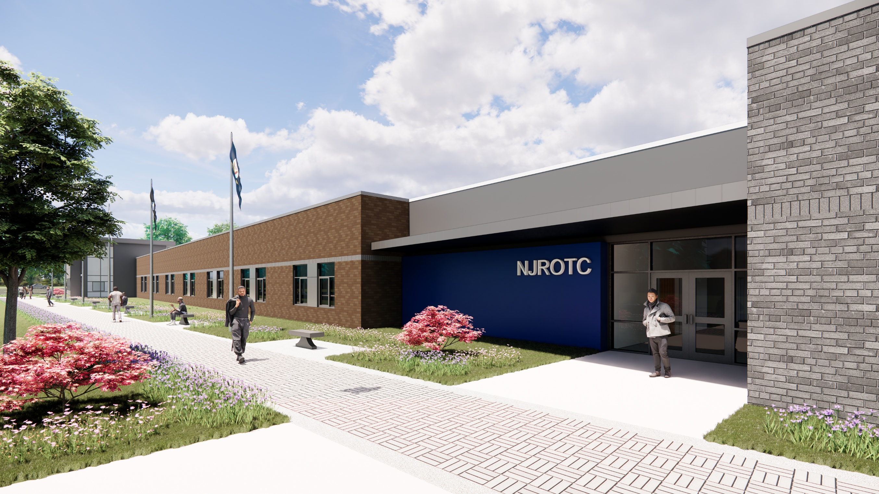
NJROTC & CLASSROOMS
SILVER BLUFF HIGH SCHOOL RENDERING
AIKEN COUNTY PUBLIC SCHOOL DISTRICT SILVER BLUFF HIGH SCHOOL | October 14, 2025 | P-16

Slide 17
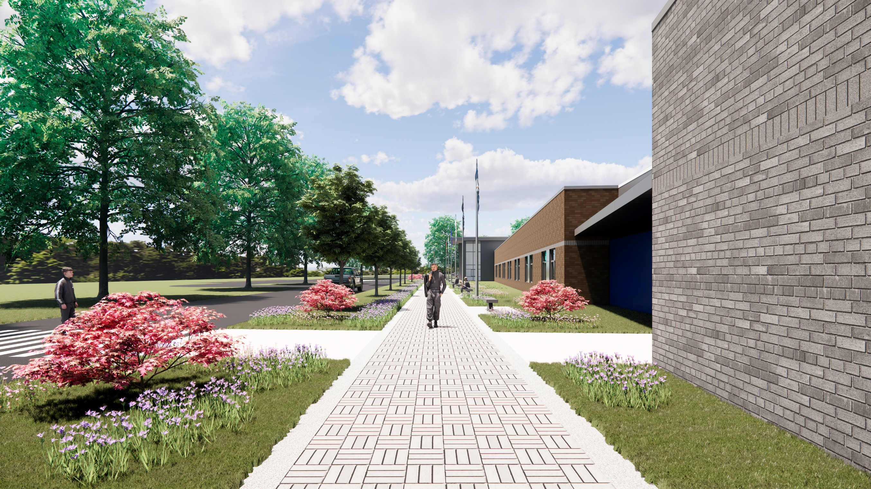
VETERANS WALK
SILVER BLUFF HIGH SCHOOL RENDERING
AIKEN COUNTY PUBLIC SCHOOL DISTRICT SILVER BLUFF HIGH SCHOOL | October 14, 2025 | P-17

Slide 18
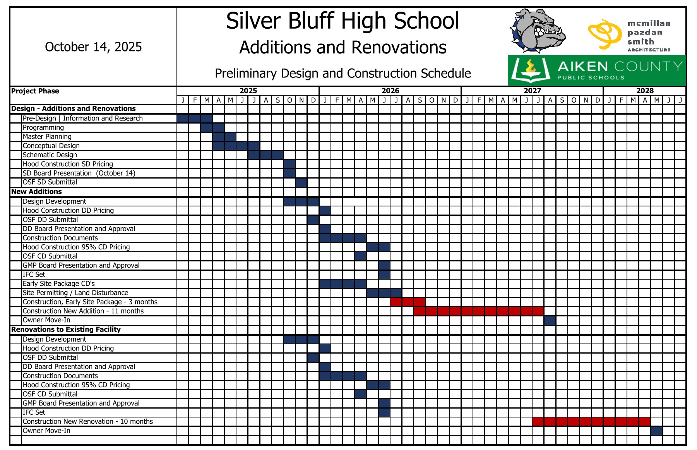
SCHEDULE
AIKEN COUNTY PUBLIC SCHOOL DISTRICT SILVER BLUFF HIGH SCHOOL | October 14, 2025 | P-18

Slide 19
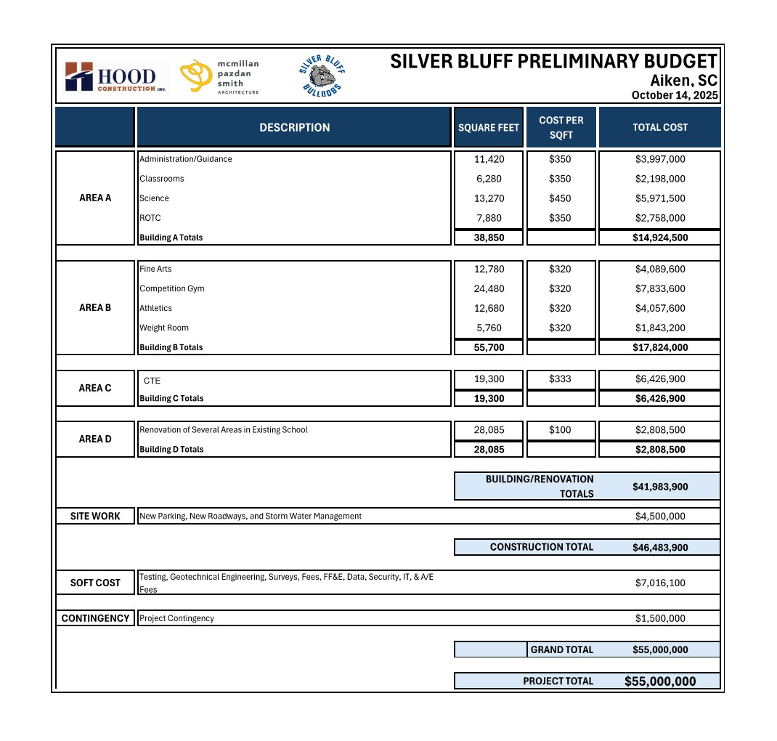
BUDGET
AIKEN COUNTY PUBLIC SCHOOL DISTRICT SILVER BLUFF HIGH SCHOOL | October 14, 2025 | P-19

Slide 20
QUESTIONS & COMMENTS
11
AIKEN COUNTY PUBLIC SCHOOL DISTRICT SILVER BLUFF HIGH SCHOOL | October 14, 2025 | P-20

